Slide 1
Federated Learning

Slide 2
Definition
“Federated Learning (FL) is a machine learning technique that enables multiple entities to collaboratively learn a shared model without exchanging their local data.”
Daly, Katharine, et al. Federated Learning in Practice: Reflections and Projections. arXiv:2410.08892, arXiv, 11 Oct. 2024. arXiv.org, https://doi.org/10.48550/arXiv.2410.08892.

Slide 3
Motivation
Federated learning may be applicable when:
Training data cannot be shared directly due to privacy concerns.
Decentralized compute is available to use for training.
Applicable to both high- and low-end compute.
Notes:
Decentralized compute can
lower the cost for those attempting to train the model
Be used when many low-power devices (i.e. IoT) are available
Be used when multiple high-power resources (i.e. datacenters from multiple institutions) are available

Slide 4
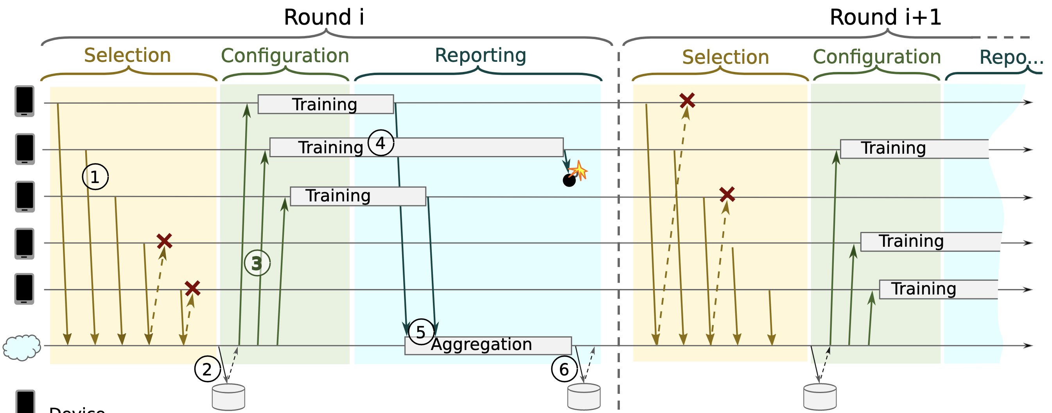
Generic Protocol
Bonawitz, Keith, et al. Towards Federated Learning at Scale: System Design. arXiv:1902.01046, arXiv, 22 Mar. 2019. arXiv.org, https://doi.org/10.48550/arXiv.1902.01046.
Notes:
Lowest line is server, all other lines are devices
Not all devices are used for every training round
Depending on the deployment, some devices with training data may even be rejected for a training round.

Slide 5
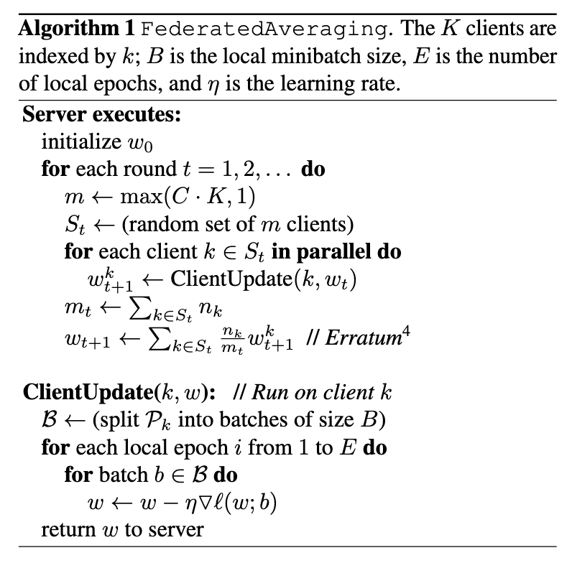
Generic Algorithm
Model is initialized, typically with random parameters, sometimes with pre-trained model
Algorithm from: McMahan, H. Brendan, et al. Communication-Efficient Learning of Deep Networks from Decentralized Data. arXiv:1602.05629, arXiv, 26 Jan. 2023. arXiv.org, https://doi.org/10.48550/arXiv.1602.05629.

Slide 6
Generic Algorithm
Many ”rounds” of training, as clients gather new data
Algorithm from: McMahan, H. Brendan, et al. Communication-Efficient Learning of Deep Networks from Decentralized Data. arXiv:1602.05629, arXiv, 26 Jan. 2023. arXiv.org, https://doi.org/10.48550/arXiv.1602.05629.
Notes:
This is not to be confused with the traditional machine learning notion of rounds, as many many rounds of training are done with the same data in machine learning, federated learning rounds consist of many traditional machine learning rounds of training.

Slide 7
Generic Algorithm
A subset of clients are selected for training
Algorithm from: McMahan, H. Brendan, et al. Communication-Efficient Learning of Deep Networks from Decentralized Data. arXiv:1602.05629, arXiv, 26 Jan. 2023. arXiv.org, https://doi.org/10.48550/arXiv.1602.05629.
Notes:
Depending on the needs of your deployment, your C may be 1, you may train on all available clients, or may only train on some clients, even when all clients have new data

Slide 8
Generic Algorithm
All selected clients are given the current version of the model (may be initial, may be from previous rounds)
Algorithm from: McMahan, H. Brendan, et al. Communication-Efficient Learning of Deep Networks from Decentralized Data. arXiv:1602.05629, arXiv, 26 Jan. 2023. arXiv.org, https://doi.org/10.48550/arXiv.1602.05629.

Slide 9
Generic Algorithm
Client trains model on multiple batches of local data and returns trained model to server.
Algorithm from: McMahan, H. Brendan, et al. Communication-Efficient Learning of Deep Networks from Decentralized Data. arXiv:1602.05629, arXiv, 26 Jan. 2023. arXiv.org, https://doi.org/10.48550/arXiv.1602.05629.

Slide 10
Generic Algorithm
Counting the number of training samples across all clients.
Algorithm from: McMahan, H. Brendan, et al. Communication-Efficient Learning of Deep Networks from Decentralized Data. arXiv:1602.05629, arXiv, 26 Jan. 2023. arXiv.org, https://doi.org/10.48550/arXiv.1602.05629.

Slide 11
Generic Algorithm
Model parameters are updated through a weighted average of client model parameters.
(Weighted average based on number of training samples the client used.)
Algorithm from: McMahan, H. Brendan, et al. Communication-Efficient Learning of Deep Networks from Decentralized Data. arXiv:1602.05629, arXiv, 26 Jan. 2023. arXiv.org, https://doi.org/10.48550/arXiv.1602.05629.

Slide 12
Federated learning is a simple concept with many variations.

Slide 13
These variations start with the system architecture itself.

Slide 14
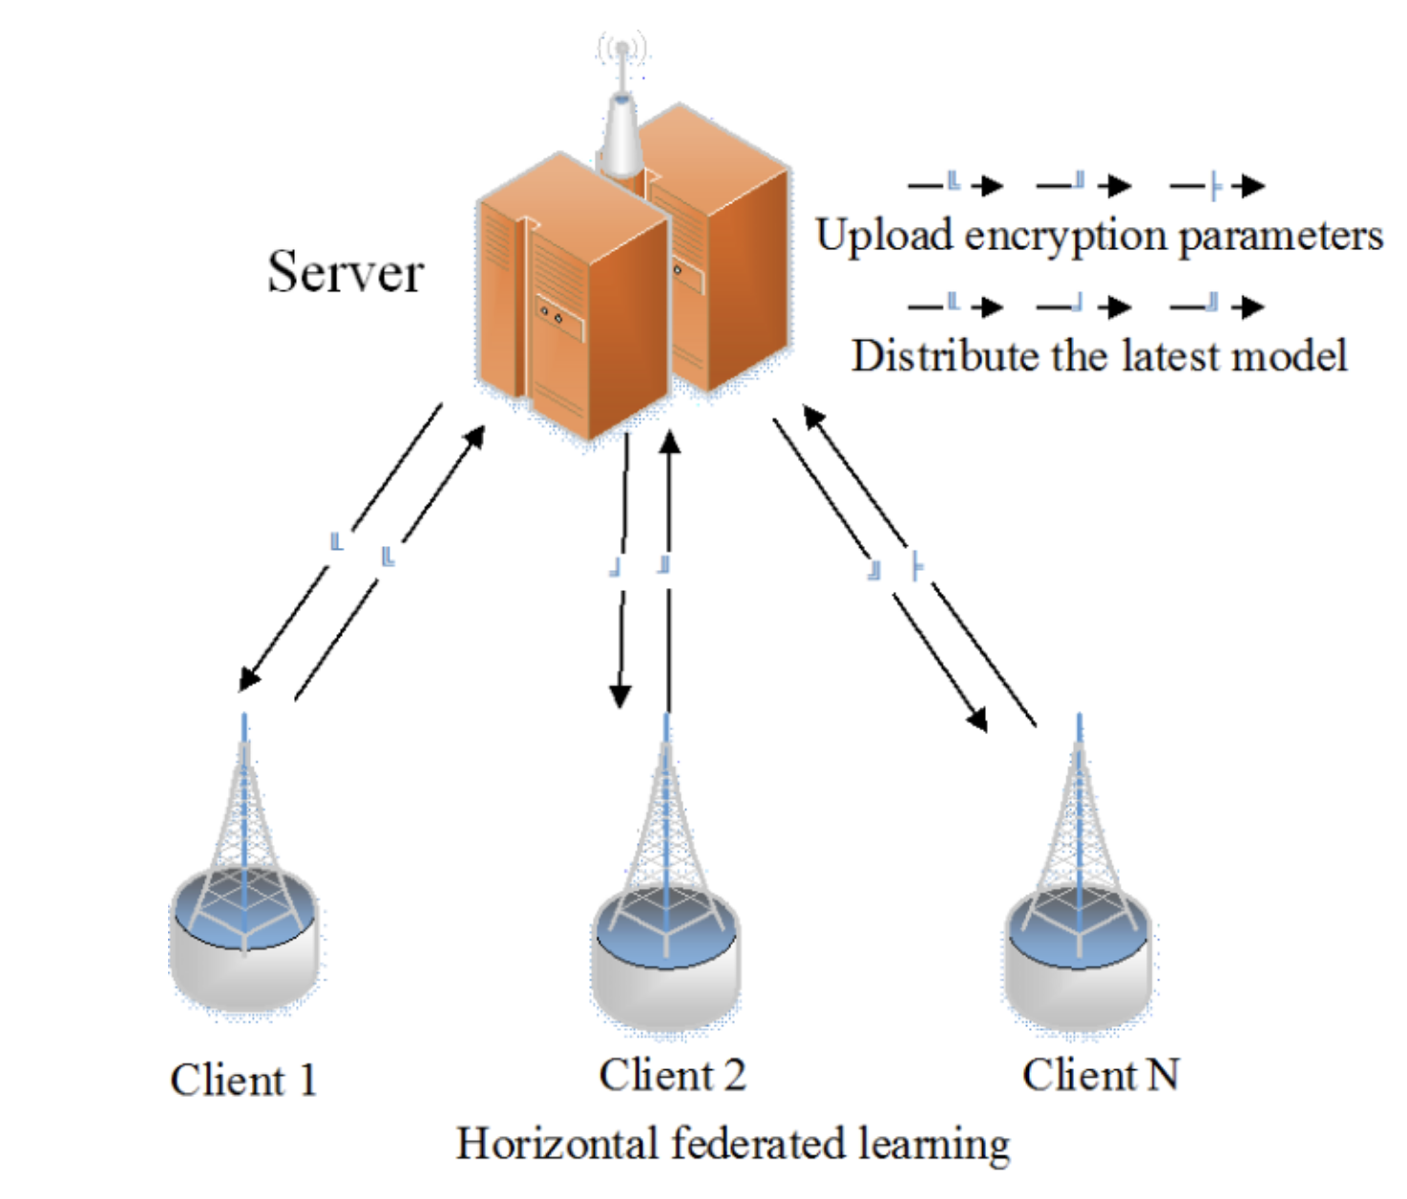
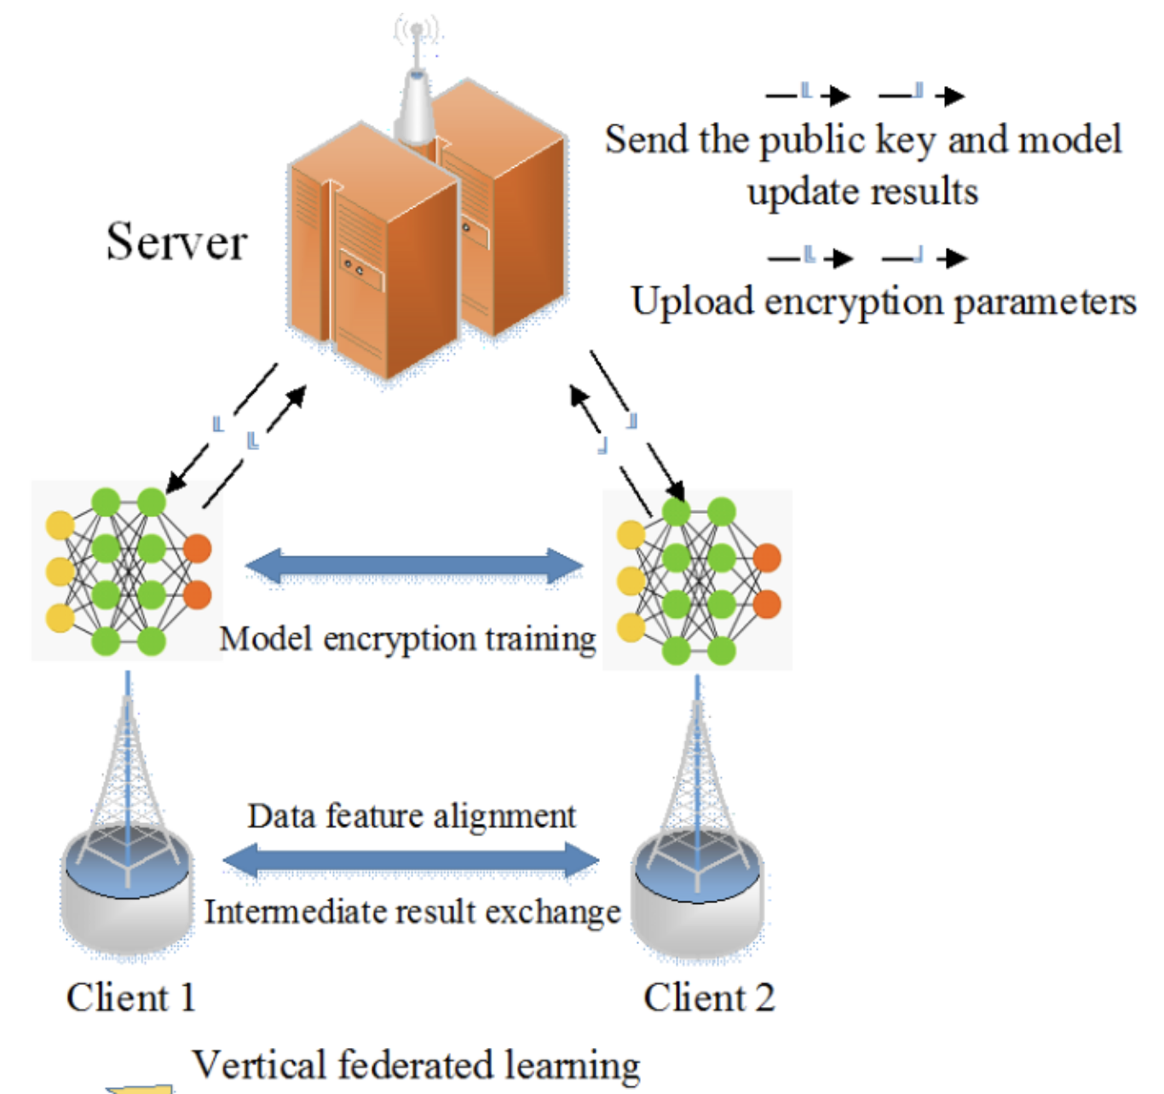
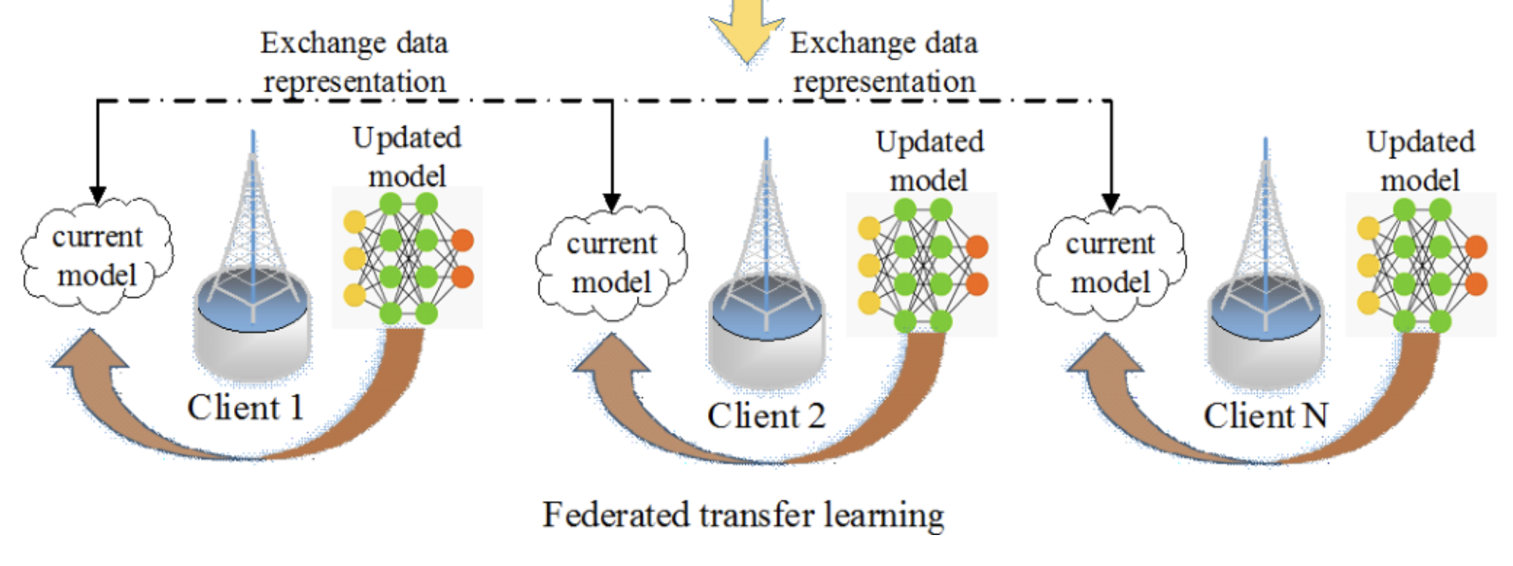
Paradigms
Wen, Jie, et al. “A Survey on Federated Learning: Challenges and Applications.” International Journal of Machine Learning and Cybernetics, vol. 14, no. 2, Feb. 2023, pp. 513–35. DOI.org (Crossref), https://doi.org/10.1007/s13042-022-01647-y.

Slide 15
Horizontal Federated Learning
Model sent from server to clients.
Clients train the model on local data.
Clients send their models back to the server.
Server aggregates learning.
Best for homogenous data.
Wen, Jie, et al. “A Survey on Federated Learning: Challenges and Applications.” International Journal of Machine Learning and Cybernetics, vol. 14, no. 2, Feb. 2023, pp. 513–35. DOI.org (Crossref), https://doi.org/10.1007/s13042-022-01647-y.

Slide 16
Vertical Federated Learning
Model sent from server to clients.
Clients with heterogenous data coordinate feature overlap.
Joint training with encrypted data.
Wen, Jie, et al. “A Survey on Federated Learning: Challenges and Applications.” International Journal of Machine Learning and Cybernetics, vol. 14, no. 2, Feb. 2023, pp. 513–35. DOI.org (Crossref), https://doi.org/10.1007/s13042-022-01647-y.

Slide 17
Federated Transfer Learning
Model is passed from client to client and trained on the way.
Can be executed without a server/orchestrator.
Training similar to traditional ML, doesn’t require aggregation
Wen, Jie, et al. “A Survey on Federated Learning: Challenges and Applications.” International Journal of Machine Learning and Cybernetics, vol. 14, no. 2, Feb. 2023, pp. 513–35. DOI.org (Crossref), https://doi.org/10.1007/s13042-022-01647-y.

Slide 18
Further Variations
Aggregation
Variants on traditional federated averaging
Gradient-based
Introducing attention
Adaptive federated optimization
Privacy
Secure multi-party computation
Differential privacy
Homomorphic encryption
Communication Efficiency
Model Compression
Federated Dropout
Structured & Sketched Updates
Additionally: Data/Model Heterogeneity, Client Selection Strategies

Slide 19
Thank You

